Slide 1
2. Study of Linux installation procedure and consideration points.

Slide 2
Objectives
Able to get informations to install Linux
Able to configure interative Linux installation
Able to install Linux
Notes:
Before getting ready to use Linux in everyday work, the first thing we have to do is to install it on our machines.
To complete this task, we need certain information about the installation and to understand underlying mentioning.
Fortunately, we don’t have to work at the lowest level of the system. Every distribution of Linux includes now a graphic installer, which will help us on installing Linux.
Anyway, we need to master the necessary for installation information in order to get a proper installation.
After this lesson, we can install Linux with most popular basic features on the machine.

Slide 3
Content
Preparation of installation
Things to decide
Installation example
Installation Verification
Notes:
We’ll begin with the preparation of installation. Of course, we can not install Linux on nothing. We need a machine and certain hardware condition for it. Our Linux system can be standalone or dual with other operation system. So partitioning and backup data are also needed.
There are several option to install Linux on our machine. Which options are used depends on our need, our gouts and our style.
After discussion, of course we’ll try to take an example of installation.
In the end, we’ll discuss about how to get sure that we have a proper installation of Linux

Slide 4
Preparation of installation
Hardware preparation
Storage
Peripheral
Software preparation
Backup old software
Choose a distribution
Plan for dual installation
Strategy of installation
Notes:
Before starting an installation of Linux, we need to checkout our system to be sure that we have enough disk space to install Linux, to know about hardware configuration of the system.
We also need to know what kind of operating system, application software and data are stored in our computer. We need to backup these software and data for the case that we want to return to our old system.
After that, depending on our need, our style, we’ll choose which Linux Distribution we’ll use. By example, if we like graphics interface and user friendly system, rpm-based distribution will be a good choice. But if we need a strict, well structured system, debian-based system will be more preferred.
In addition, each distributer provide several type of installation. It can be server installation, office desktop installation or expert installation. Based on our needs and our capability we need to choice a proper strategy of installation

Slide 5


Installation workflow
Notes:
Procedure for installing Linux.
Before installing Linux, we must decide on the purpose of the system which will determine the distribution to use, the type of hardware, and the network configuration. Once we have this information, we proceed to acquire the necessary software and hardware. After these preparations have been completed, we will start the installation.
Installation work is performed based on the four procedures.
(1) Hardware determination
(2) Decision of installation policy
(3) Installation
(4) Environmental setting after the installation
Hardware determination, requires you to ascertain, the type of mouse, the display type, the video adapter type, the amount of disk free space, etc. Once we have this information, we need to decide whether these hardware meet the requirement for a Linux system that you are going to install.
As for the installation policy, decide on the installation options of Linux based on your usage. For instance, the number of disk partitions, packages to install, network configuration, etc.
We will be using the Red Hat Enterprise Linux for our installation exercise.
Environmental setting will be done after the installation, Those settings include network, adding of new users, addition/deletion of packages, start/stop of services, etc. These settings will be explained in detail in the following chapters.

Slide 6
Investigation of hardware
Hard disk
Input/output device
Keyboard: type and layout
Mouse: type
Video card
Display
Notes:
Hardware componnents of a computer is enough complicate for new Linux users. Fortunately, to have a working installation of Linux, we need to know informations for only certain type of hardware. This includes: Keyboard, mouse, video card and display.
Even for those hardwares, installation program will autodetects type and the corresponding drivers for them. Except for specific hardware, in most of cases, you don’t have to worry wbout hardware. Linux distributor update drivers rapidly enough to support new hardware.
Anyway, it’s better to know some detail informations about hardware, in order to have them work efficiently.

Slide 7
Things to decide before installtion
Choice of installation disk(s)
File hierarchie and mapping to disk
Partitioning
Single/Dual Booting
Notes:
There are several options to decide before beginning installation. If the computer has more than 1 hard disk, then Linux will be install on one of them. Its recommended to install Linux on a separate hard disk, and if you have enough disks, separate disk for data and run time information.
After choosing the disk, the file structure is next item to choose. Linux natively support 2 file systems: ext2 and ext3. ext3 file system can be considered as ext2 file syste plus journal function. So ext3 file system can be recovered if the system is reset. Of course, journal function affect the performance and use certain amount of disk space. Based on the needs and the configuration of the system, we have to choice one of them.
The next step is to partition the hard disk. Partitioning itself is not difficult, most of installation program have a user-friendly tools to partition hard disk. The important and complex task is to design the layout of the disk.
Linux needs at least 2 partitions: One for the system (/) and other for swap. Swap partition is the partition used for virtual memory. Differently as in MS Windows, where the virtual memory is stored in a swap file, in Linux its stored in a separate swap partition. It prevents performance influence and interference between normal file and swap file accessing, but it limits the maximum size of virtual memory.
In Linux, temporary files, user data, system and application software can be stored in different partition. If you want to store them, you have to plan it now.
The last issue is to choose how the system boot, especially in the case that 2 operating systems are installed. You can choose by examples to boot with MS Windows menu, with option to boot Linux, or boot with Linux menu with Windows option.

Slide 8
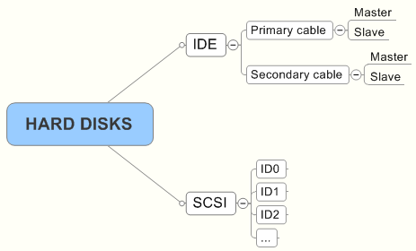
Installation disk
IDE/SCSI/SATA
IDE
Primary: Master/Slave: /dev/hda, /dev/hdb
Secondary: Master/Slave: /dev/hdc, /dev/hdd
SCSI
Id0,id1, …..
/dev/sda, /dev/sdb/, /dev/sdc
USB disks are considered as SCSI
Notes:
There are several type of connection to hard disk: IDE, SCSI, SATA, ….
Basically, IDE disk are indentified by /dev/hd*, where * is a letter. So /dev/hda is primary master. /dev/hdb is primary slave, /dev/hdc is secondary master. /dev/hdb is secondary slave harddisk.
SCSI hard disk is notated by /dev/sd*, wheare * is a letter.
USB disks are emulated as SCSI disks
Be careful with the names of the partitions. If you confuse between the names, you have risk to erase entire partition or disk with valuable data on it. In some case, partitions and disks are named automatically at the startup of the system. Consecutively, they can be named differently as they are installed. So the system can be non-bootable.

Slide 9
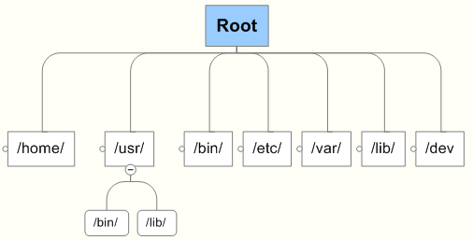
File hierarchie and mapping
SWAP
P1
P2
P3
P4
HDD1
HDD2
HDD3
Notes:
By default, Linux stores programs and data in directories with standard names. It helps Linux users to find out where are the files. Most important directories and their use are:
/home: contents users home directories, where users can stores their own data.
/usr: contents users programs
/bin: contents most executable files or their shortcuts
/etc: contents system’s and applications configuration files
/var: place to store temporary files
/lib: static and dynamic binary libraries are stored in this folder
/dev: content special (device) files used to manage physical devices
/proc: image of bios data
/boot: contents files necessary for booting the syste,
….
It is possible to install all of these directory on one partition. However, to have better performance, directory with different roles are recommended to install on separate partition. Which directory is connected to which partition, we have to decide before installing Linux, because it will complicate when installation is finished. Bad choice of parrtition configuration can lead to inefective use of the system, even crash by the lack of disk space.

Slide 10
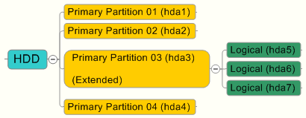
Partitioning
Notes:
Deciding which partition of the hard disk to install the system. If there is another OS installed on the disk, it is necessary for you to store Linux in another partition.
Originally, the hard disk of the IBM PC/AT compatible machine was able to be divided only into four primary partitions. However, today we can create more than five partitions by creating extended partition.
The are three kinds of partition:
• Primary partition : Basic partition segmentation methodology on the compatible machine. It is possible to divide up to 4 primary partitions.
• Extended partition : Partition which set to divide hard disk into five areas or more. When extended partition is made instead of a basic partition, you can make a logical partition in the extended partition.
• Logical partition : Partition that can be created in an extended partition. A logical partition can store data as in a basic partition.The partitions are created during the installation of Linux. The installation destination is specified by the device name that contains the partition number.
Device name that contains partition number:
hdax ‘x’ part is the partition number.
1 - 4 : Number given to basic partition and extended partition
5 - : Number put on logical partition. The number is set in order of the definition.

Slide 11
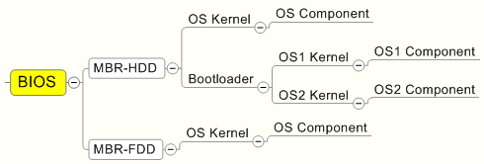
Understanding bootloader
File System
Partition
HDD
Notes:
Normal boot of a computer begins with BIOS program, This program will read the first sector of the first disk in priority. In this sector, there will be a small program looks for OS kernel, load it if found and pass the control to it to start loading the OS itself
In case of dual, triple and more boot, it is necessary to have a program that allows users to choose which OS to boot. This program must be loaded by BIOS or by the program in the first sector of the disk. This program is called boot loader. Each OS has its own loader. MS Windows has so called ntloader. Linux has several option of boot loader. These loaders have to be configured to boot others OS.
Our task is to choose the proper boot scenario of the system, and then configuration the boot loader to realize it.
When use Linux boot loader standalone, we can choose to install boot loader on Linux partition or on the first section of the hard disk. Both boot our system in to Linux.
When use Linux boot loader with other OS, we can also choose to install boot loader on Linux partition or on the first section of the hard disk. Both boot our system in to Linux. The only different it that when we uninstall Linux, the boot loader stay in the first record of the hard disk, but has no data to run. So the system will halt after uninstalling Linux.
Otherwise, we need to place the /boot folder of the Linux system on the accessible area of the hard disk. Some Linux boot loader can not read the partition begin after 20G space, then if we place our Linux boot directory in the partition, the boot loader can not load the OS and the system will also halt.

Slide 12
Installation example
Install method
Partitioning
BootLoader
Network
FireWall
Local Support
Root authentication
Package selection
Notes:
Now we will follow a typical installation of Linux. The setup program will help us to collect inforamation for the future system. We will pass sime steps as:
Install method
Partitioning
BootLoader
Network
FireWall
Local Support
Root authentication
Package selection

Slide 13
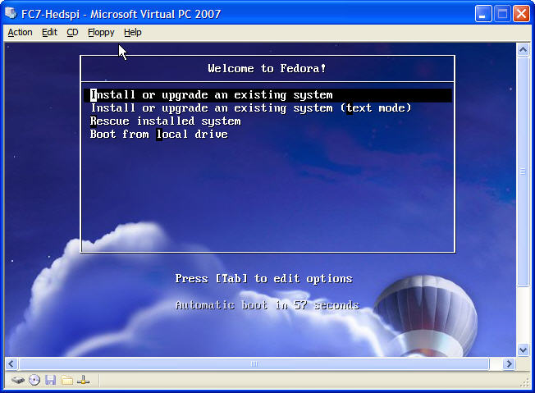
Install Method

Slide 14
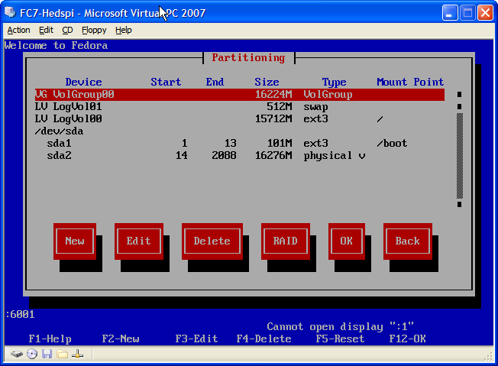
Partitioning

Slide 15
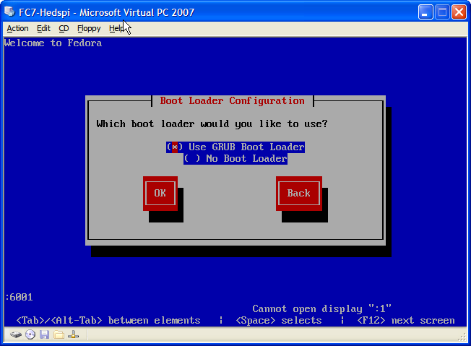
BootLoader

Slide 16
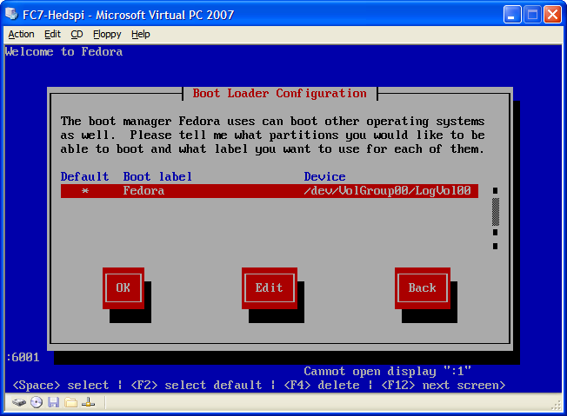
BootLoader

Slide 17
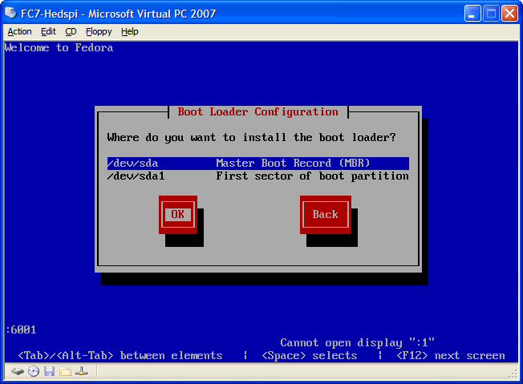
BootLoader

Slide 18
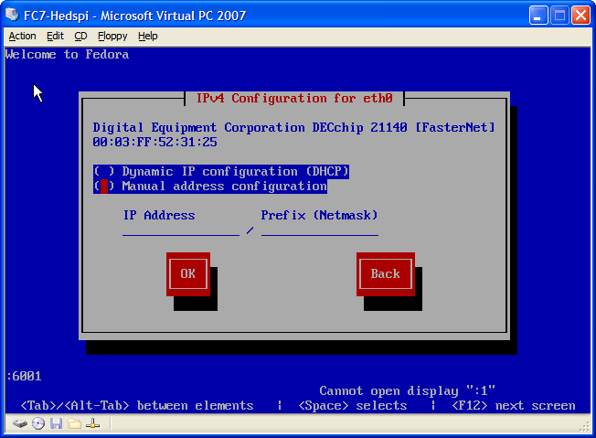
Network

Slide 19
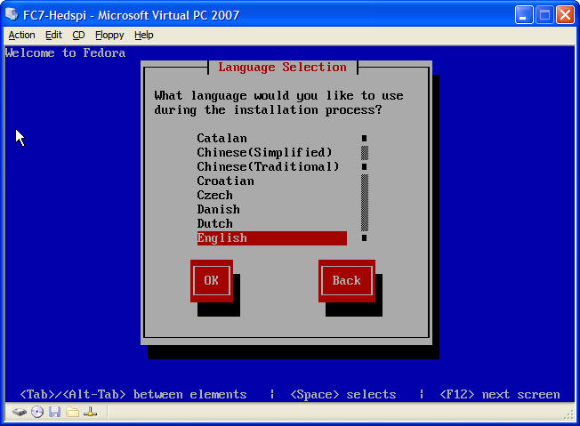
Local Support

Slide 20
Local Support

Slide 21
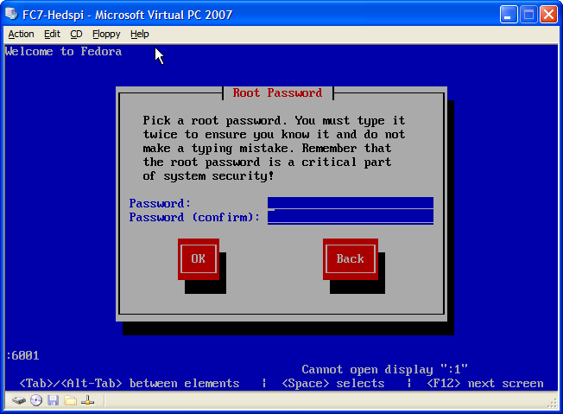
Root authentication

Slide 22
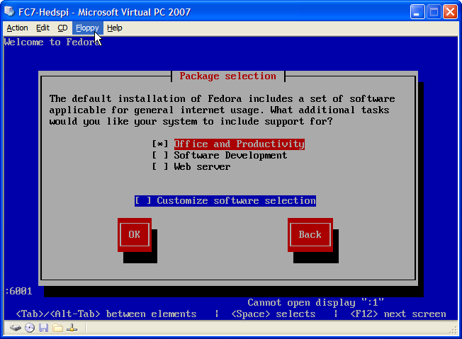
Package selection

Slide 23
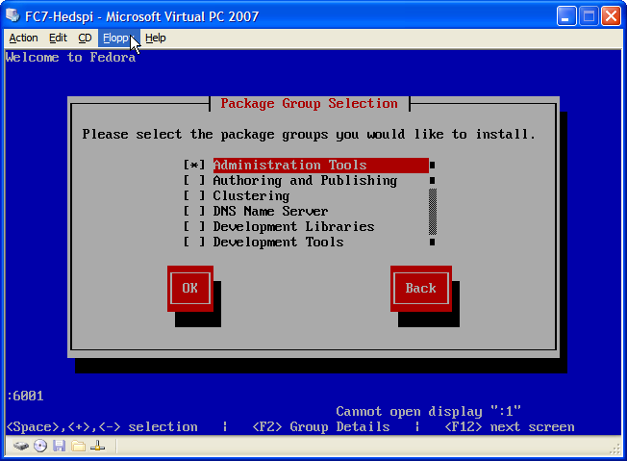
Package selection

Slide 24
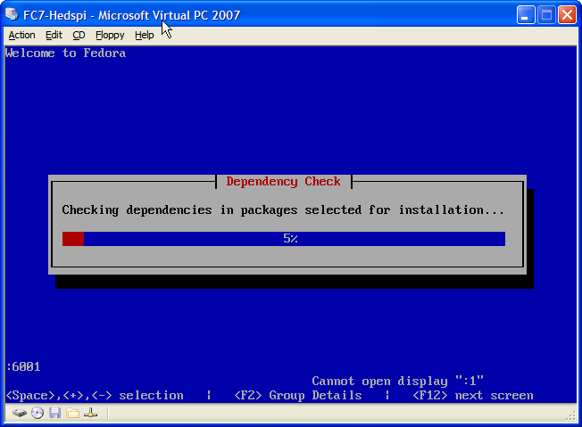
Starting Installation

Slide 25
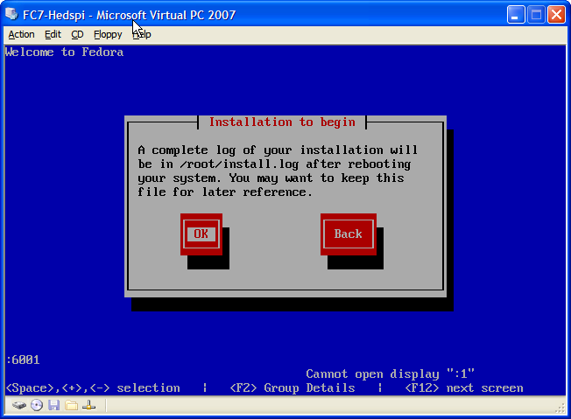
Starting Installation

Slide 26
Information for installation
Hardware
Language and keyboard layout
Disk partitioning
Bootloader
Network
Root account
Application choices

Slide 27
Verification
Login to the system
Check the version (in case of multiple installation)
Notes:
After the installation is finished, the system will restart
If the installation is completed successfully, then now a login promt will appears in graphics or in text mode, depends on the configuration of the system and the setup program.
Now try to login with root. When successful, we will have a promt as in the figure.
Now try to login with an user. When successful, we will have a promt as in the figure.
Type uname –a <enter> to get information about the system.

Slide 28
Summary
Preparing for installation:
Software, Hardware, Installation Source
Check points of installation:
Getting information: Language, Keyboard Layout, HDD Layout, BootLoader, Network, Software choice, ...
Starting installation
Verification of installation

